Slide 1

Netflix Data Analysis
Prepared by :-
Darshankumar Patel , Vishesh Makwana , Helina Gandhi , Reema Patel

Slide 2
Table of contents
1.) | Business Problem
2.) | Analytics Questions
3.) | Data Source Overview
4.) | Data Visualizations
5.) | Insights from Data Visualizations & Analysis
6.) | Potential Solution Optimization
7.) | Overall Performance

Slide 3
Business Problem
Netflix, a leading global streaming service, is facing challenges in optimizing its content strategy and user engagement. As the platform offers an extensive library of TV shows and movies, it is crucial for Netflix to understand viewer preferences and interests accurately. To maintain its competitive edge and improve customer satisfaction, Netflix needs to leverage data analysis to gain insights into its content performance, user behavior, and the impact of different shows on its platform. The company aims to identify patterns, trends, and viewer preferences to make informed decisions about content acquisition, production, and personalization of recommendations.

Slide 4
Analytics Questions
Some of the Analytics Questions are as follows:-
Which is more popular TV shows or Movies?
What the number of movies and TV shows released per year?
What kind of rating is more popular?
Which directors have contributed more on Netflix?
Which Actors is most popular on Netflix?
Which Country have more content on Netflix?
Which movies or TV shows are more watched by audience based on category?

Slide 5
Data source overview
It contains the information about the TV shows and Movies on Netflix
It defines each TV show or Movie with the following parameters:
Show_id, type, title, director, actor(cast), country, date_added, realease_year, rating, duration, listed_in, description.
These above mentioned parameters about a particular TV show or movie will help us to analyze the dataset and produce the results according to the requirements.
Data source Link:- https://www.kaggle.com/datasets/shivamb/netflix-shows

Slide 6
Data Visualizations
In Data Visualizations we will be going to see different graphs that we have made in order to get key insights from data source:-
Pie chart
Line chart
Symbol map
Bar chart
Bubble chart
Tree map
Word map

Slide 7
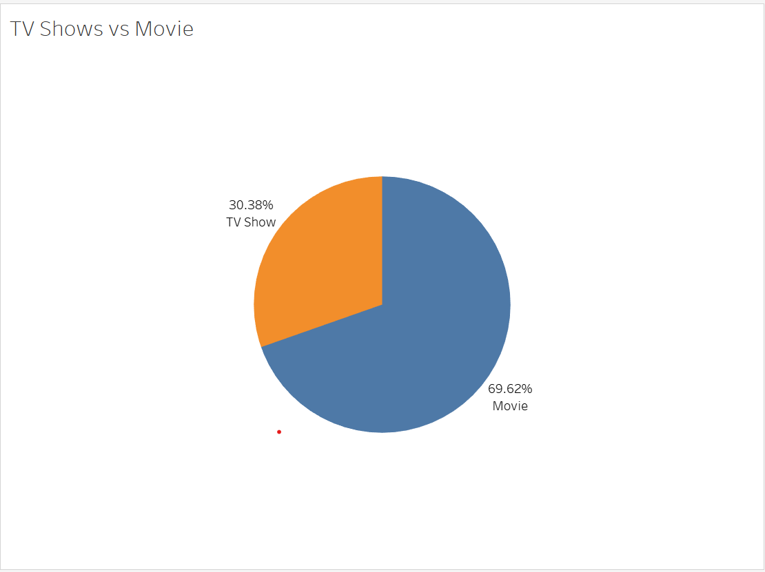
Insights from Data Visualization
According to chart, 70% of the content available on the platform are movies, while the remaining 30% are TV shows.
This shows that movies are a key component of Netflix's content offering and a substantial attraction for users.

Slide 8
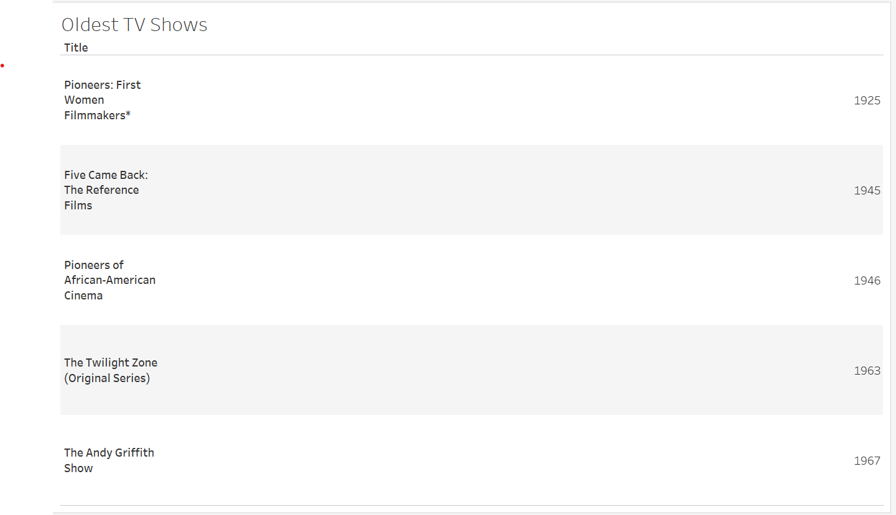
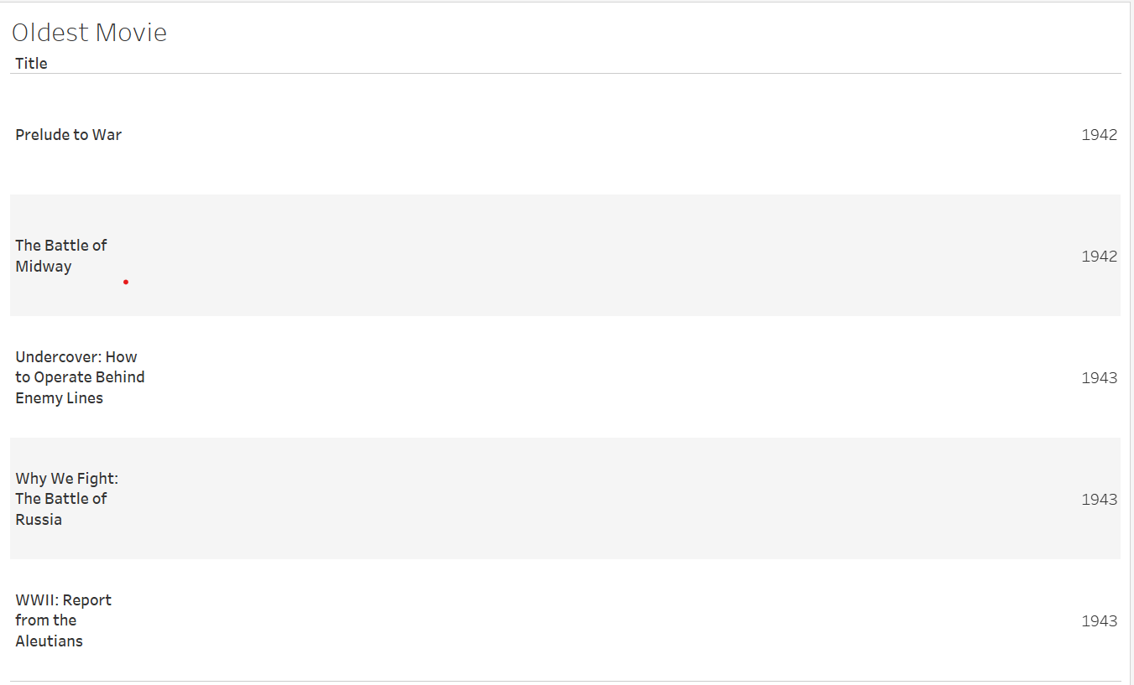
Insights from Data Visualization
The existence of the oldest television programme and movie, both from 1925 and 1942, demonstrates Netflix's dedication to selecting media with historical relevance. Viewers have the chance to discover entertainment from bygone eras and observe the development of storytelling in film and television thanks to these offers.

Slide 9
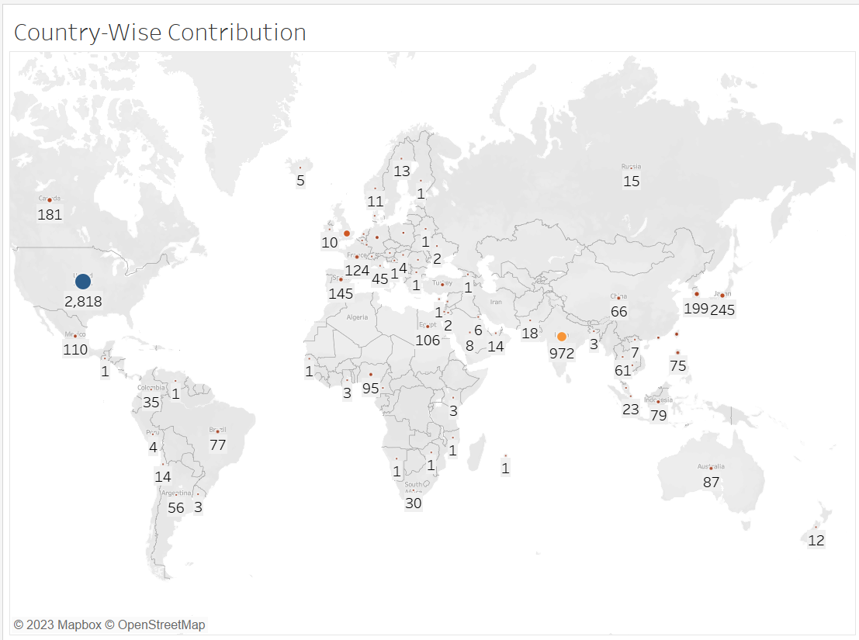
Insights from Data Visualization
Analyzing the number of TV shows and movies in the Netflix dataset by country can provide insights about platform's content distribution and viewer preferences in different countries. The United States, for example, produces a large number of both TV shows and movies, whereas India stand second after US.

Slide 10
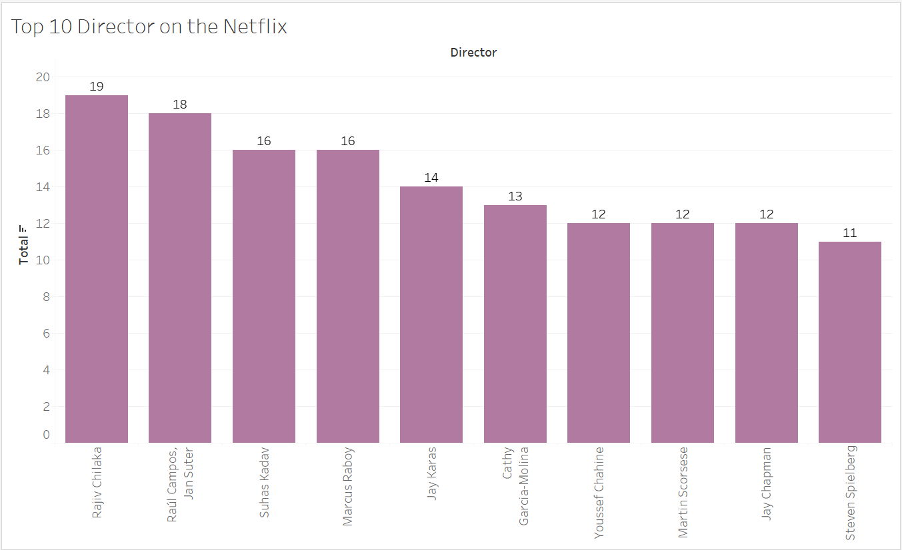
Insights from Data Visualization
Showing which Director has Produced more Movies & TV Shows.
As per analysis, Rajiv Chilaka directed 19 titles followed by other director i.e., Raul Campos,Jan Suter with 18 titles.
From the analysis we can say that they have gained recognition and popularity among viewers. Audiences may become familiar with their work and seek out content directed by them.

Slide 11
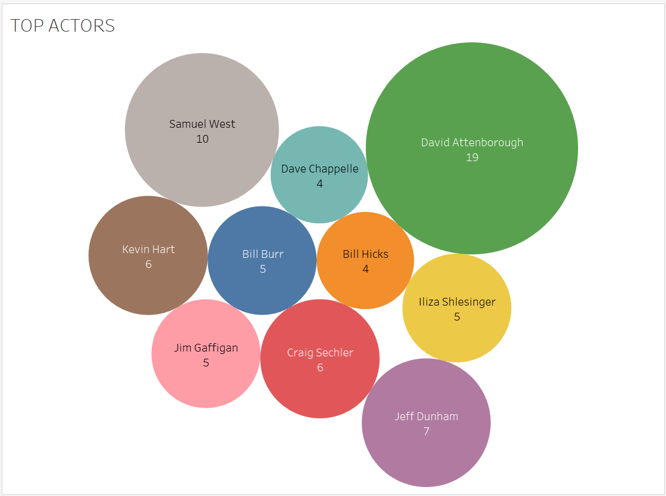
Insights from Data Visualization
Showing which Actor has been more in Movies & TV Shows.
As per analysis, David Attenborough has been in 19 Movies or TV Shows followed by other actor i.e., Samuel West with 10 Movies or TV Shows.
The presence of popular actors like David Attenborough and Samuel West can attract audiences to movies and TV shows. Viewers may be interested in watching their performances, which can positively influence viewership.

Slide 12
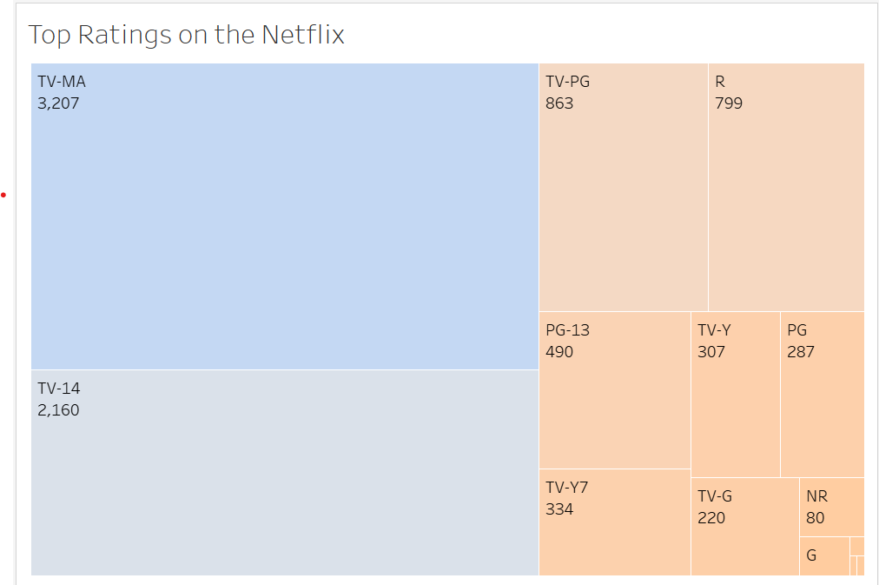
Insights from Data Visualization
Here, we conclude that TV-MA is the most common in TV Shows and Movies which indicate the viewer who uses Netflix are mostly 18+.

Slide 13
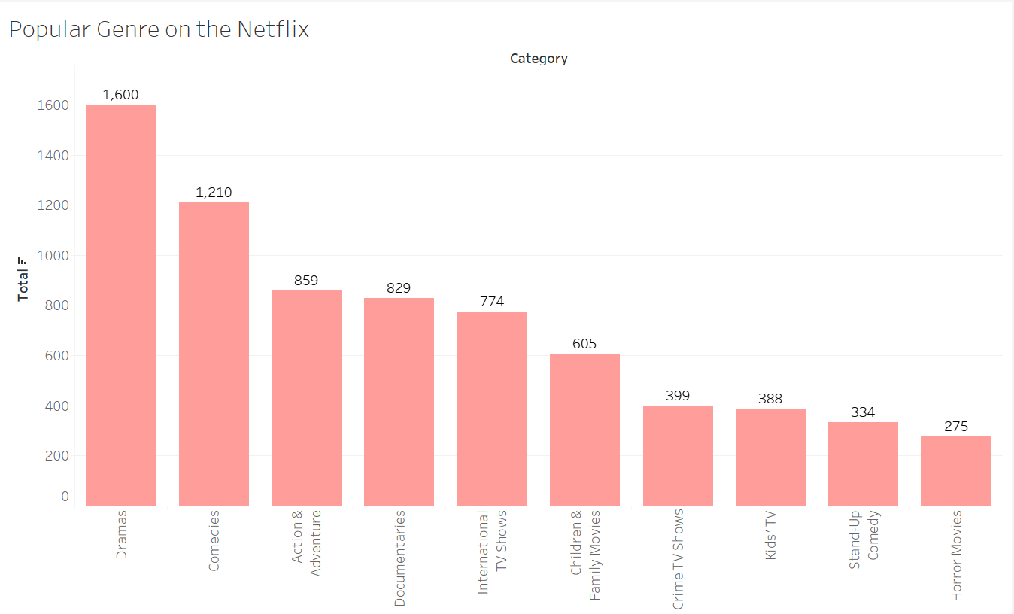
Insights from Data Visualization
Here, Drama & Comedies are most popular than other genre. Netflix may utilize it to make data-driven decisions that will enhance their user experience, content offers, and competitiveness in the streaming market.

Slide 14
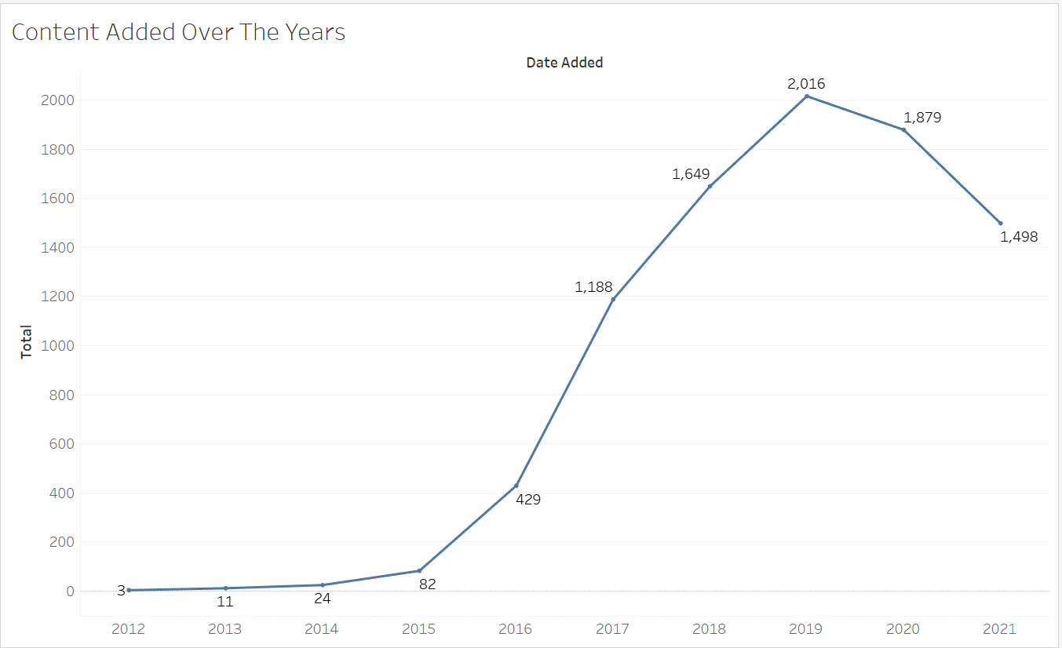
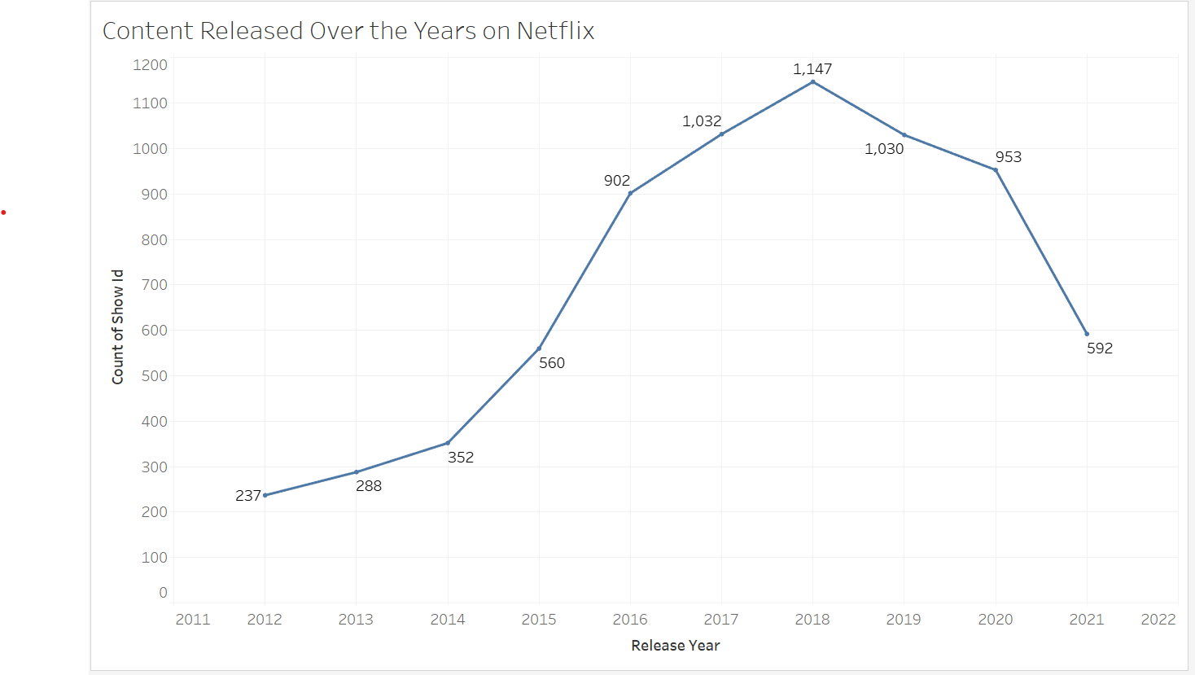
Insights from Data Visualization
The increase in content additions on Netflix has been more than the increase in material releases each year, implying that Netflix has been actively obtaining content from diverse sources to meet the demands of its audience. The delay between Netflix content releases and additions suggests that the platform is picky about which content to include in its collection, most likely based on licensing agreements, popularity, audience preferences, and content quality.

Slide 15
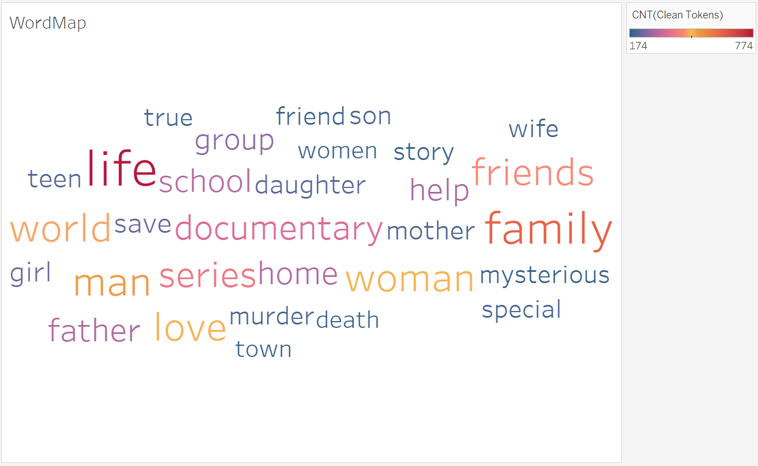
Insights from Data Visualization
The Word-map indicates that there will be more movies or TV shows that will be related to Life, Friends or Family.
Important Note:-
We have perform some data manipulation before plotting it as description contains summary of movie, we divide summary into token and then remove stop words using python(Natural Language Toolkit(NLTK) Library).

Slide 16
Potential Solution Optimization
According to the analysis, there are numerous potential solutions to optimise its platform and improve content selection, user engagement, and customer satisfaction have been found. Personalised content recommendations, targeted marketing and promotions, content investment strategy, churn prediction and retention strategies, content tagging and categorization, continuous A/B testing, expansion and localization, and content quality and user feedback analysis are examples of these solutions.

Slide 17
Overall Performance
As Netflix continues to grow and evolve, data analysis will remain a critical part of their business strategy. They will likely continue to invest in new technologies and techniques to improve their data collection and analysis capabilities.

Slide 18

Thank You
ANY QUESTIONS?

